Slide 1

End-to-End Banking Dashboard using Power BI, Python, SQL and MS Excel
Exploratory Data Analysis Project |2025
By:
Haritha Mohanavel

Slide 2
Project Objective
- Perform end-to-end EDA on customer banking data
- Use Python for initial data exploration and correlation analysis
- Load data into MySQL for scalable data handling
- Build interactive dashboards in Power BI with DAX
- Enable data-driven decision-making with engaging visuals

Slide 3
Dataset Overview
- 3,000 customer records with 25 attributes
- Key fields: Age, Risk, Income, Loans, Deposits, Gender
- Source: Extracted CSV File data into MYSQL Database
- Tools used: Power BI, DAX, Excel, Python for Exploratory Data Analysis and MY SQL

Slide 4
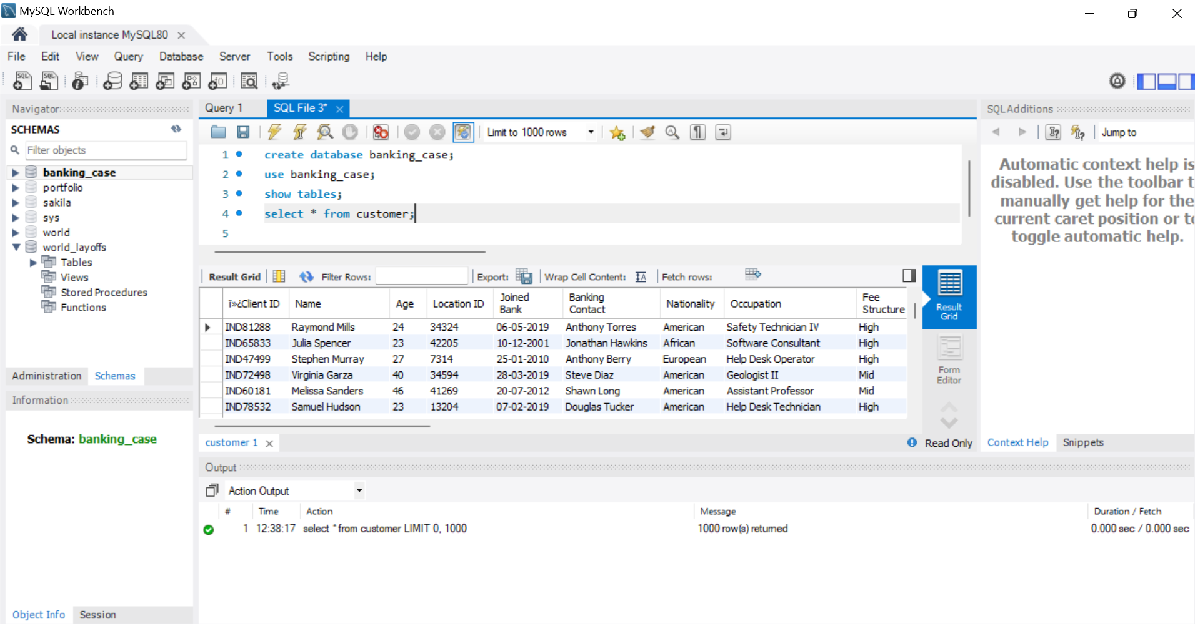
MySQL Integration: Data Connection

Slide 5
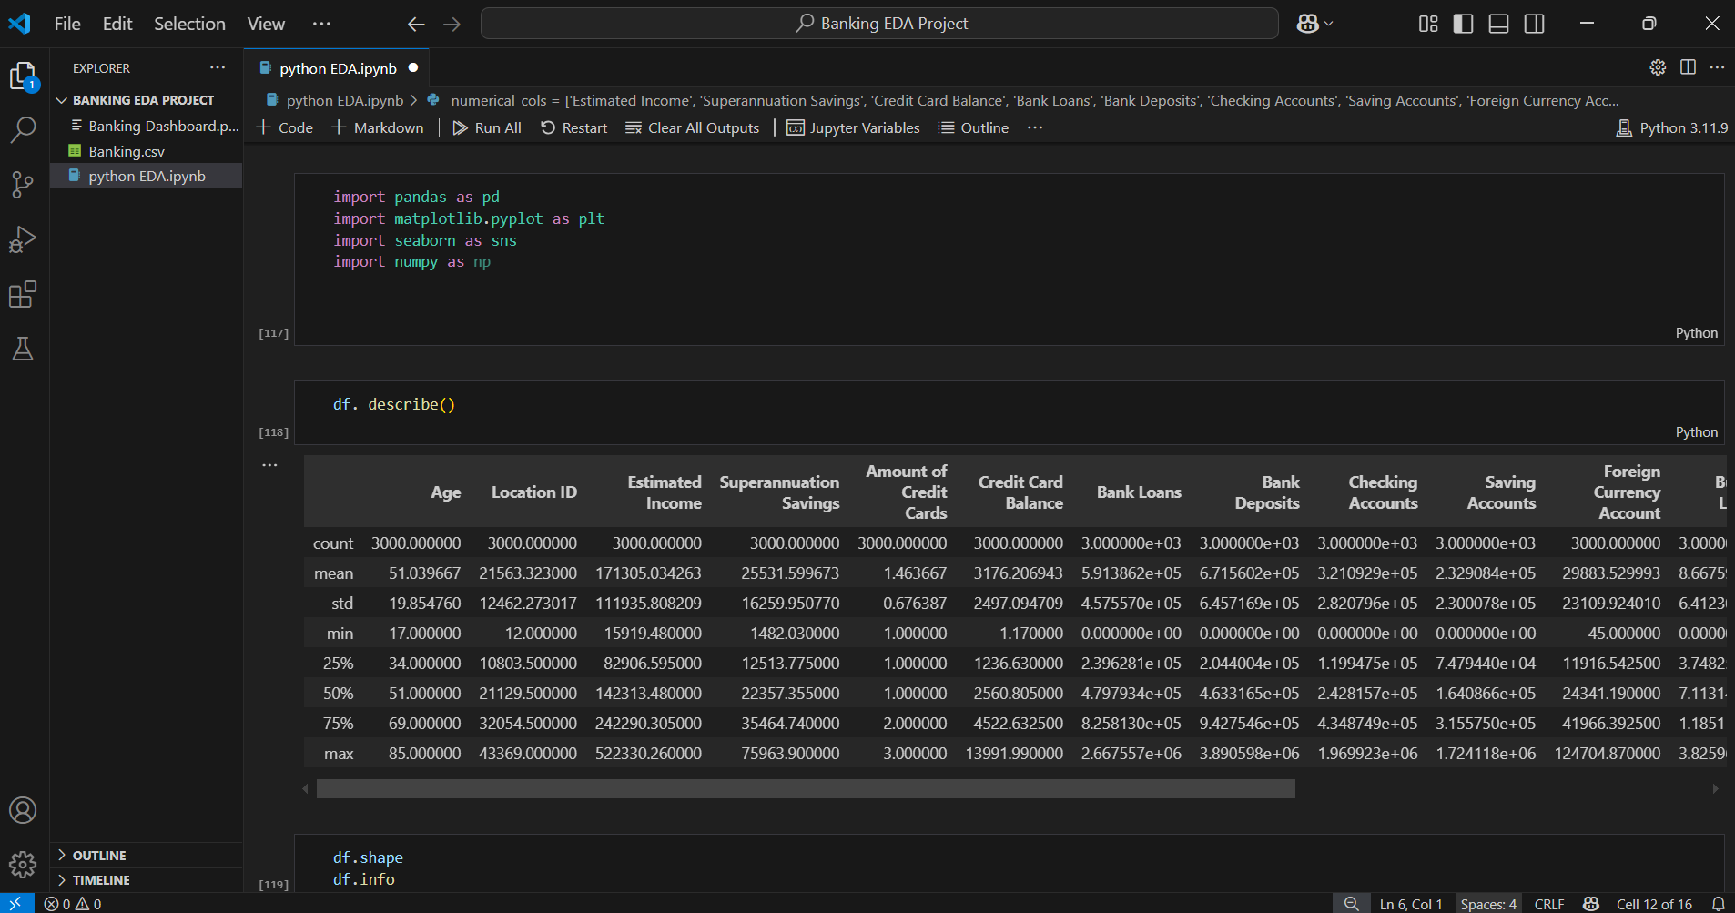
Python EDA: Data Summary with Pandas

Slide 6
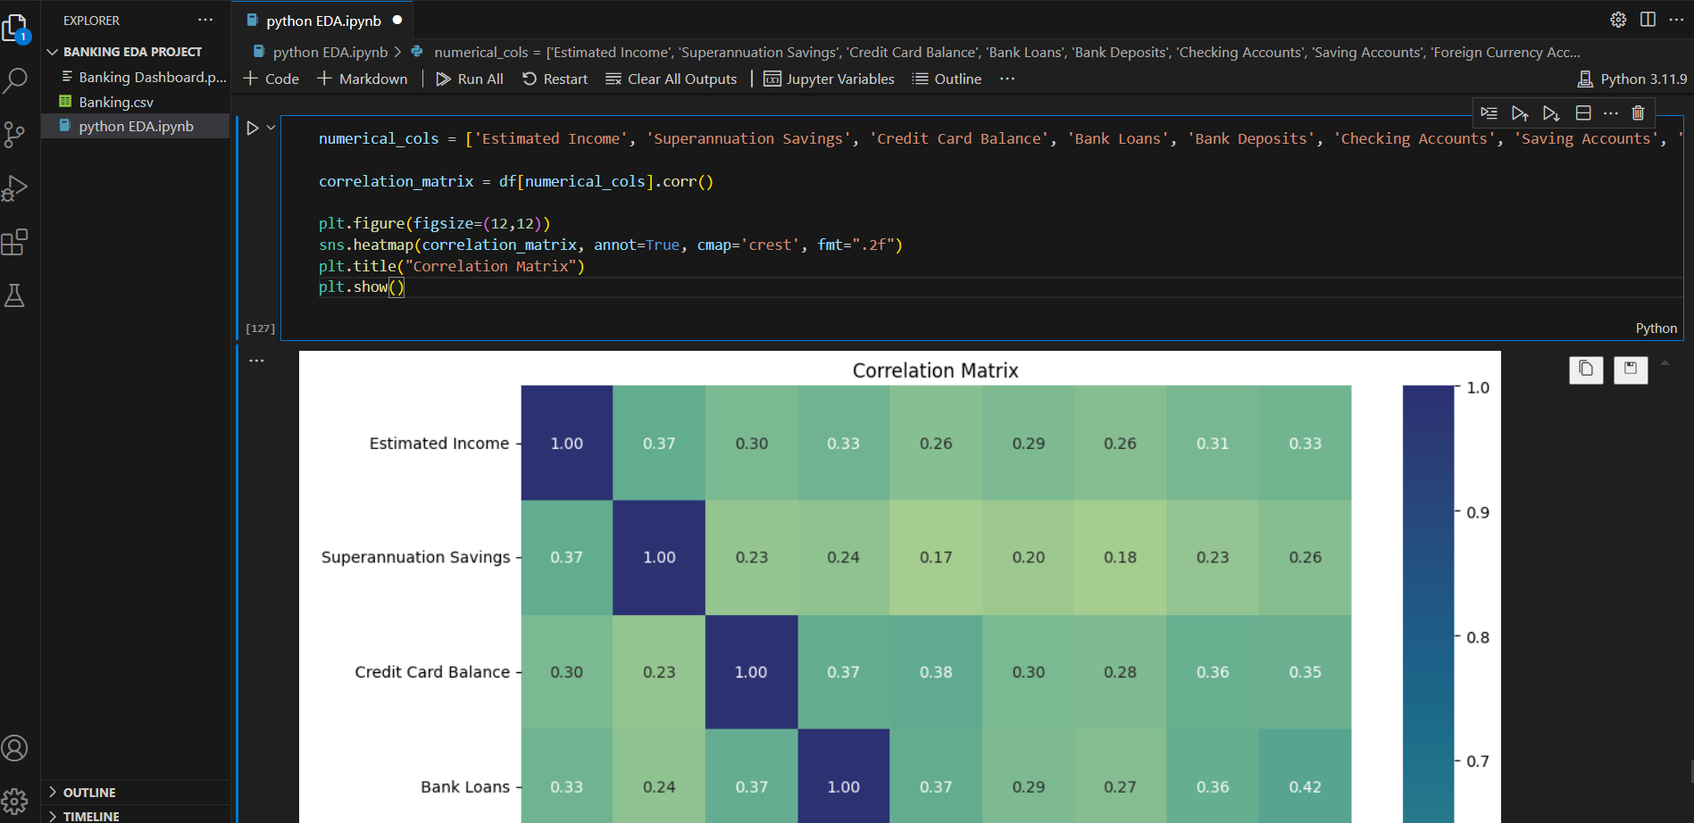
Python EDA: Correlation Analysis using Seaborn

Slide 7
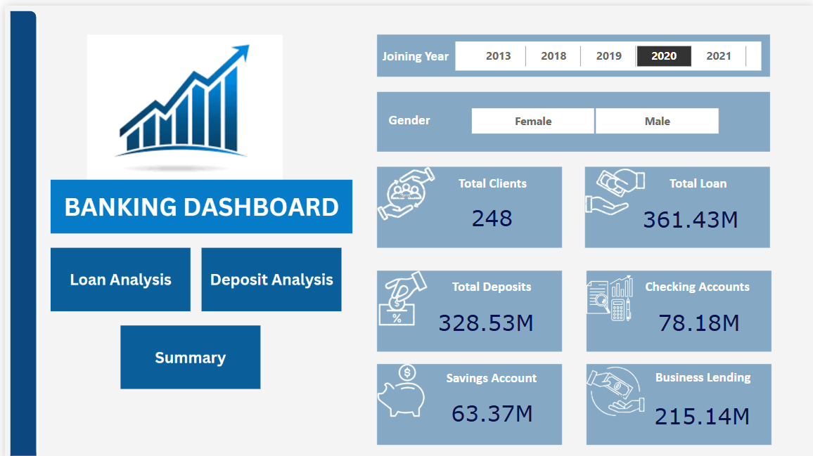
Home Page Dashboard Highlights in Power BI

Slide 8
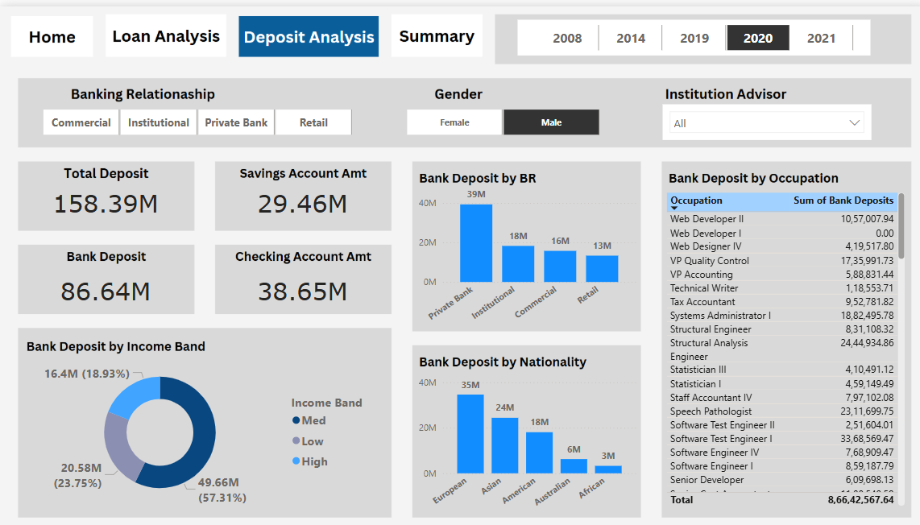
Loan Analysis Dashboard

Slide 9
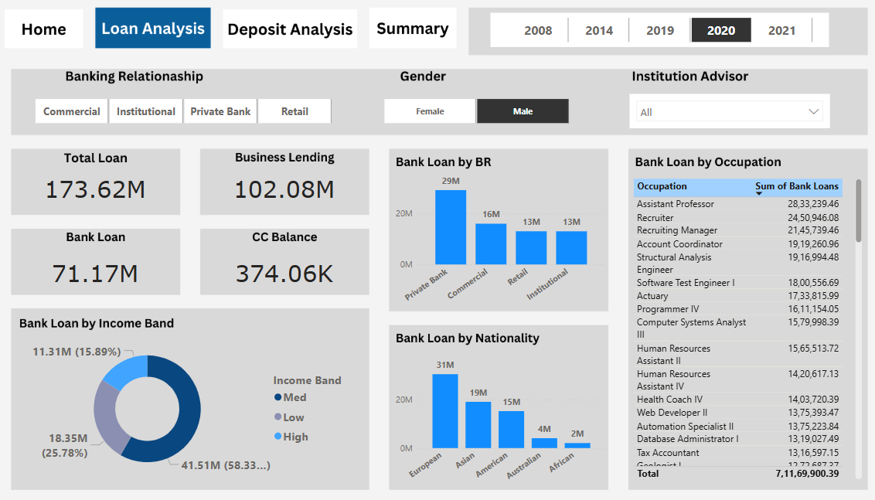
Deposit Analysis Dashboard

Slide 10
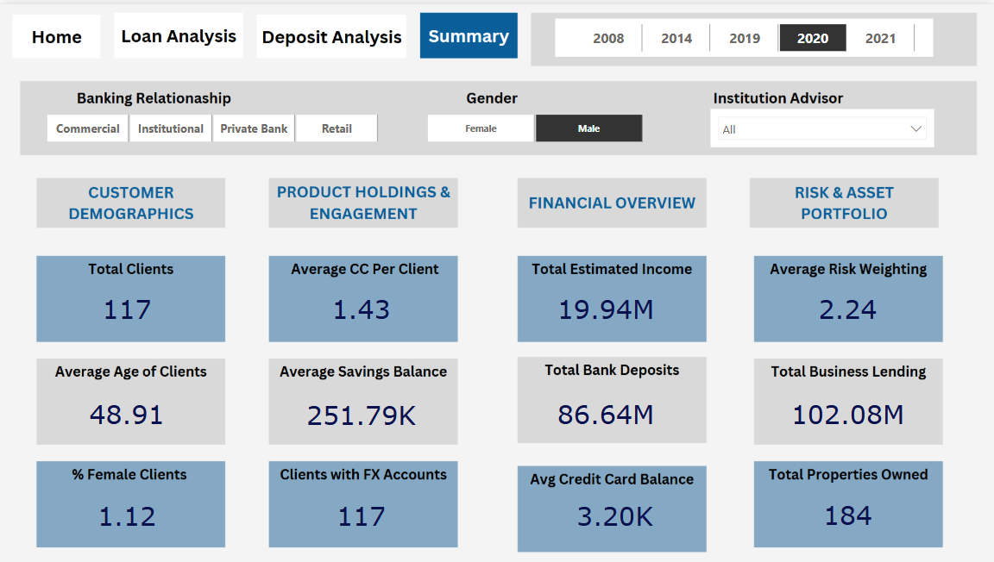
Summary Insights Dashboard

Slide 11
Learnings & Tools
- Built DAX measures to calculate KPIs
- Used slicers and filters for interactivity
- Connected CSV data to MySQL database for structured storage
- Performed exploratory analysis using Pandas, NumPy, Matplotlib, and Seaborn
- Developed business storytelling with engaging visuals
- Tools: Power BI, MySQL, Python, Excel, DAX

Slide 12
Connect With Me
📌 Let’s connect if you liked this project!
- LinkedIn: [https://www.linkedin.com/in/haritha-mohanavel-37661728b/]
- Email: [harithamohanavel08@gmail.com]
- Github: https://github.com/MSHaritha

